Slide 1
The HEPPP Retention Project
BUILDING A STUDENT-CENTRED RETENTION STRATEGY

Slide 2




Retention Team
Dr Kelly Linden
Quality Manager, FoS Retention Project Manager
Dr Prue Gonzalez
Retention Lead, FoS
Neil vanderPloeg
Project Support
Ben Hicks
Learning Analyst, DLT
Notes:
Delete
People not in the project

Slide 3
Significant increase in the average progress rate in 2018 following targeted student contact
pre HECS census, *p<0.0001.

Slide 4
Subject progress rates in subjects with and without a pre- census early assessment item.
* Progress rates in 2018 with an EAI were significantly higher an all other progress rates, p<0.05.

Slide 5
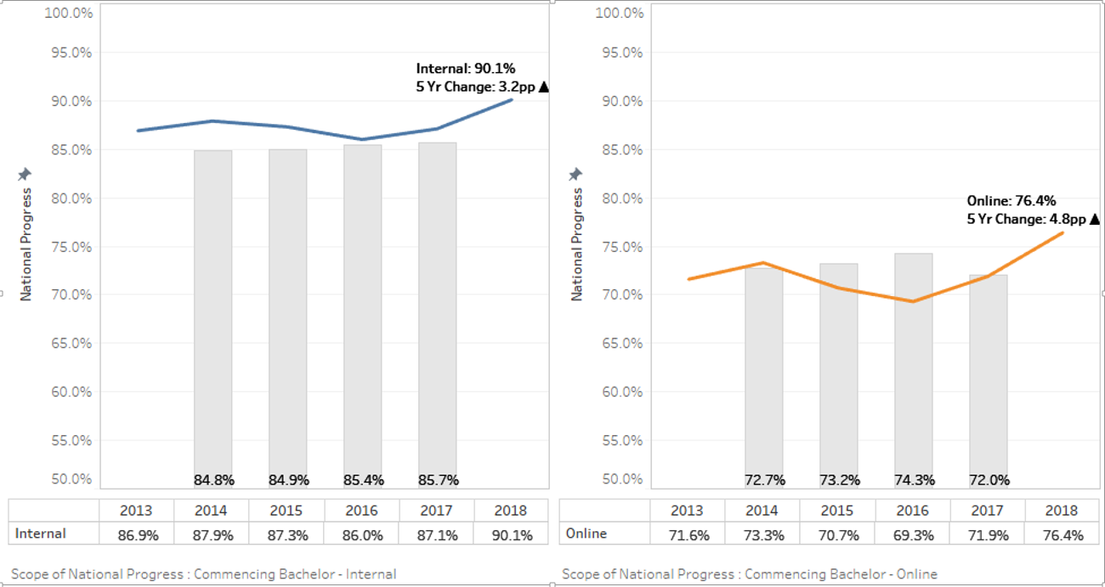
IMPACT: FOS Phase 1 & Phase 2
Significant improvements in commencing progress in Science from 2016-2018
Internal: 4.1% improvement
Online: 7.1% improvement

Slide 6
Pre-Census Model
Pre-Session
Week 1
Week 2
Weeks 3 & 4
Post-Census
Early assessment item design
LMS set up
Clearly communicated subject expectations
Phone FL students from previous session
Proactive email contact (no LMS access)
Proactive SMS, phone, email contact (no early assessment submission)
Review enrolment

Slide 7
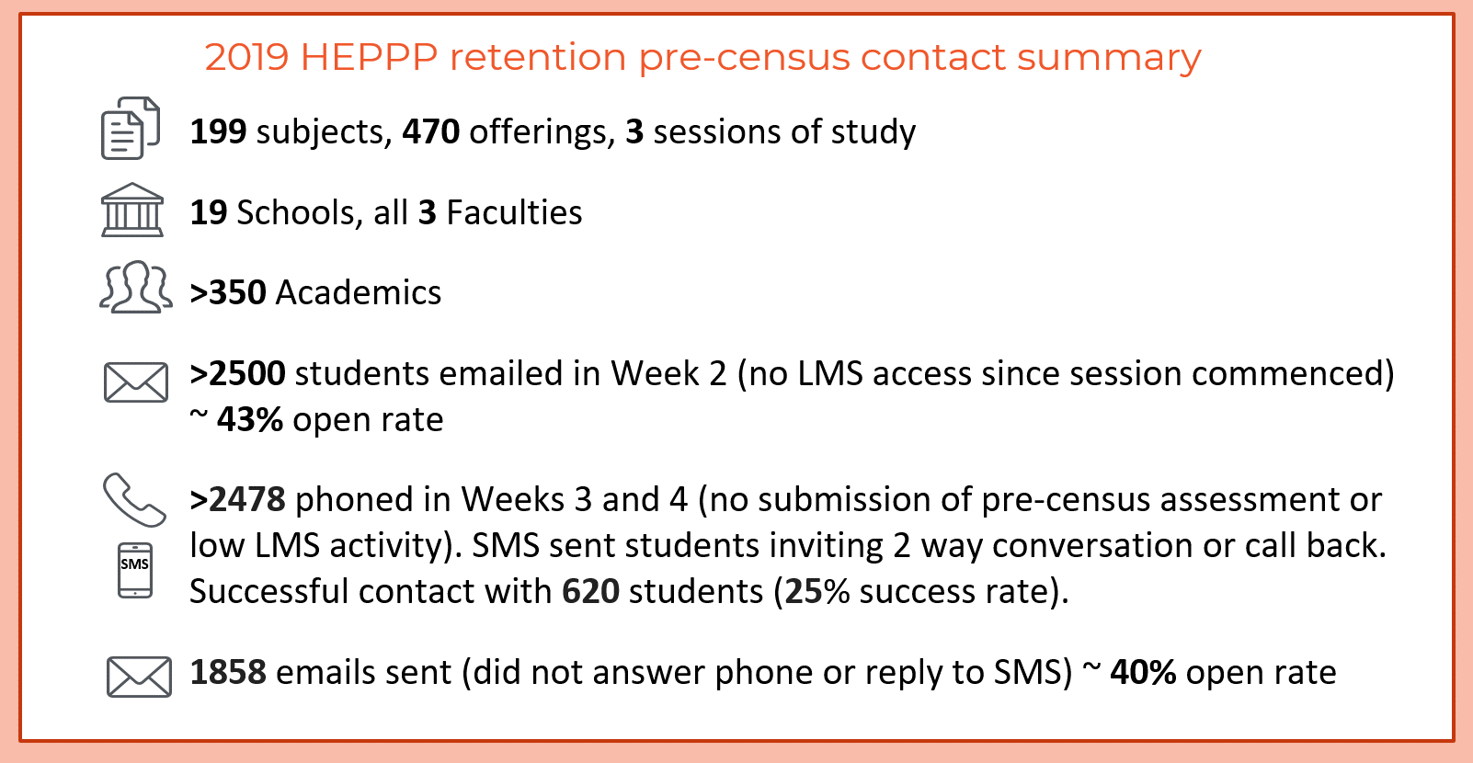

Slide 8
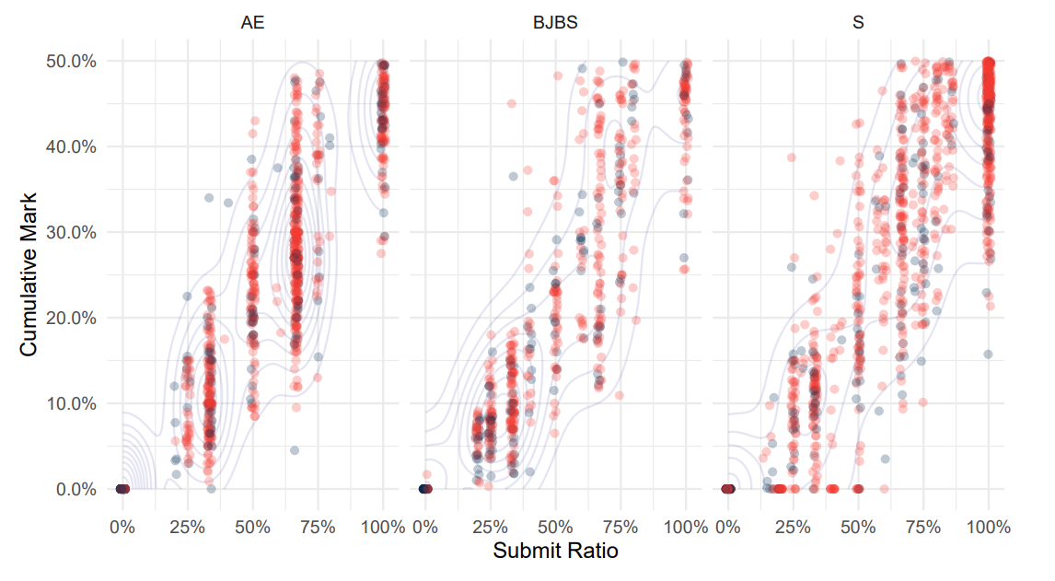
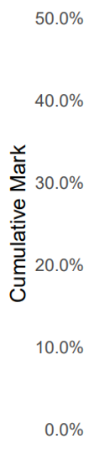

Differences in “Failing Grades” between Faculties, 2019 Session 1
FOAE
BJBS
FOS
Notes:
Focus on FoS

Slide 9
Differences in “Failing Grades” between Faculties, 2019 Session 1
FOAE
BJBS
FOS

Slide 10
This is great…
…but now with this pandemic can we do this for all subjects and all assessments?

Slide 11
HEPPPidemic
Tracked EASTS submissions
In the first 2 weeks, 350 Offerings from 202 Subjects
3209 assessments missed
≈ 65%-70% given extensions
Students going to call centre, have NOT HAD ANY contact with the academic or arranged an extension
Notes:
Students going to call centre have NOT had any contact with academic or arranged an extension

Slide 12
HEPPPidemic - Issues
Data; custodianship, purpose, urgency, accuracy
Relationships - building trust across different parts of the university
How to scale up / automate?
Notes:
Custodianship: DSA owns enrollments, DLT owned activity, DIT owned some assessments (but formally DLT), OPA owned data collection and deployment but not everything. Subject outline tool?
Purpose: OPA purpose primarily BI not LA. DSA keeps students enrolled if they owe fees; OPA only un-enrols when fully confirmed
Urgency: Most people wanted things correct, we wanted quick. Talk delay in getting missed assessment to call centre
Accuracy: Activity data story of group house, assessment in 5 or 7 for assessments,

Slide 13
HEPPPidemic at scale
~30 subjects → ~900 subjects
2 week window → 14 week window
Fixed calling window → Rolling calling window
We wanted to keep:
Strong communication channel to the academic and call-out team
Practical model output of low engagement

Slide 14
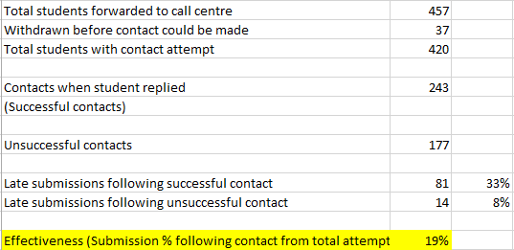
HEPPPidemicResults so far…
Notes:
Note: Data does not include all students to allow time for contacted students to take action on the contact with the call centre. This data is from 457 students.

Slide 15
Questions?

Slide 16
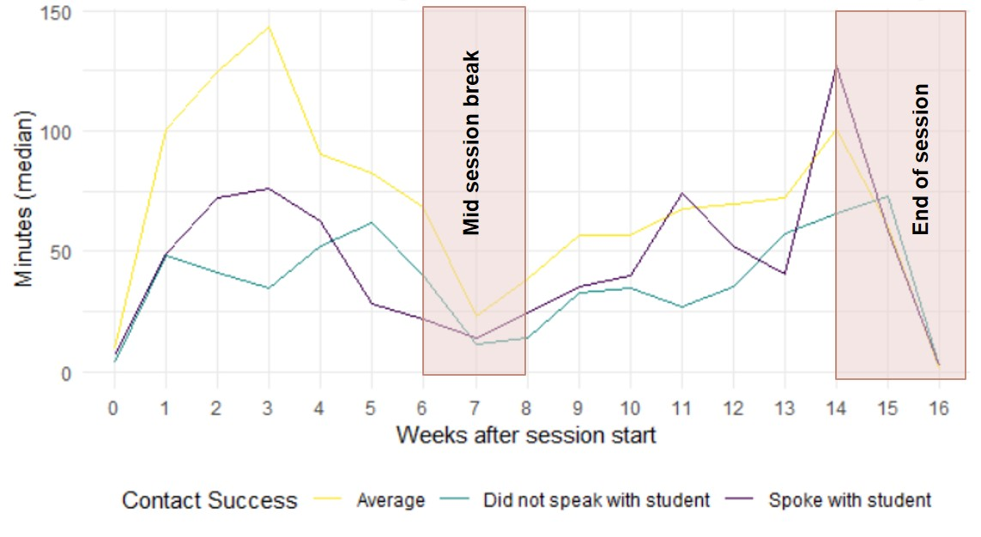

Slide 17
Higher Education Standards Panel (HESP, 2018)
Report on Improving retention, completion and success in higher education
Recommendation 5:
Every institution should have its own comprehensive student-centred retention strategy, which is regularly evaluated. These strategies could include institutional retention benchmarks and, as appropriate, processes for entry and exit interviews, the integration of data-based risk analytics and targeted support interventions, a suite of support services and a means to re-engage with students who have withdrawn.
Recommendation 6:
Institutions should automatically review the enrolment of all students who have not engaged in their studies to an agreed level by the census date.

